Slide 1







RECEPTION PARENT WORKSHOP 16TH SEPTEMBER 2025

Slide 2


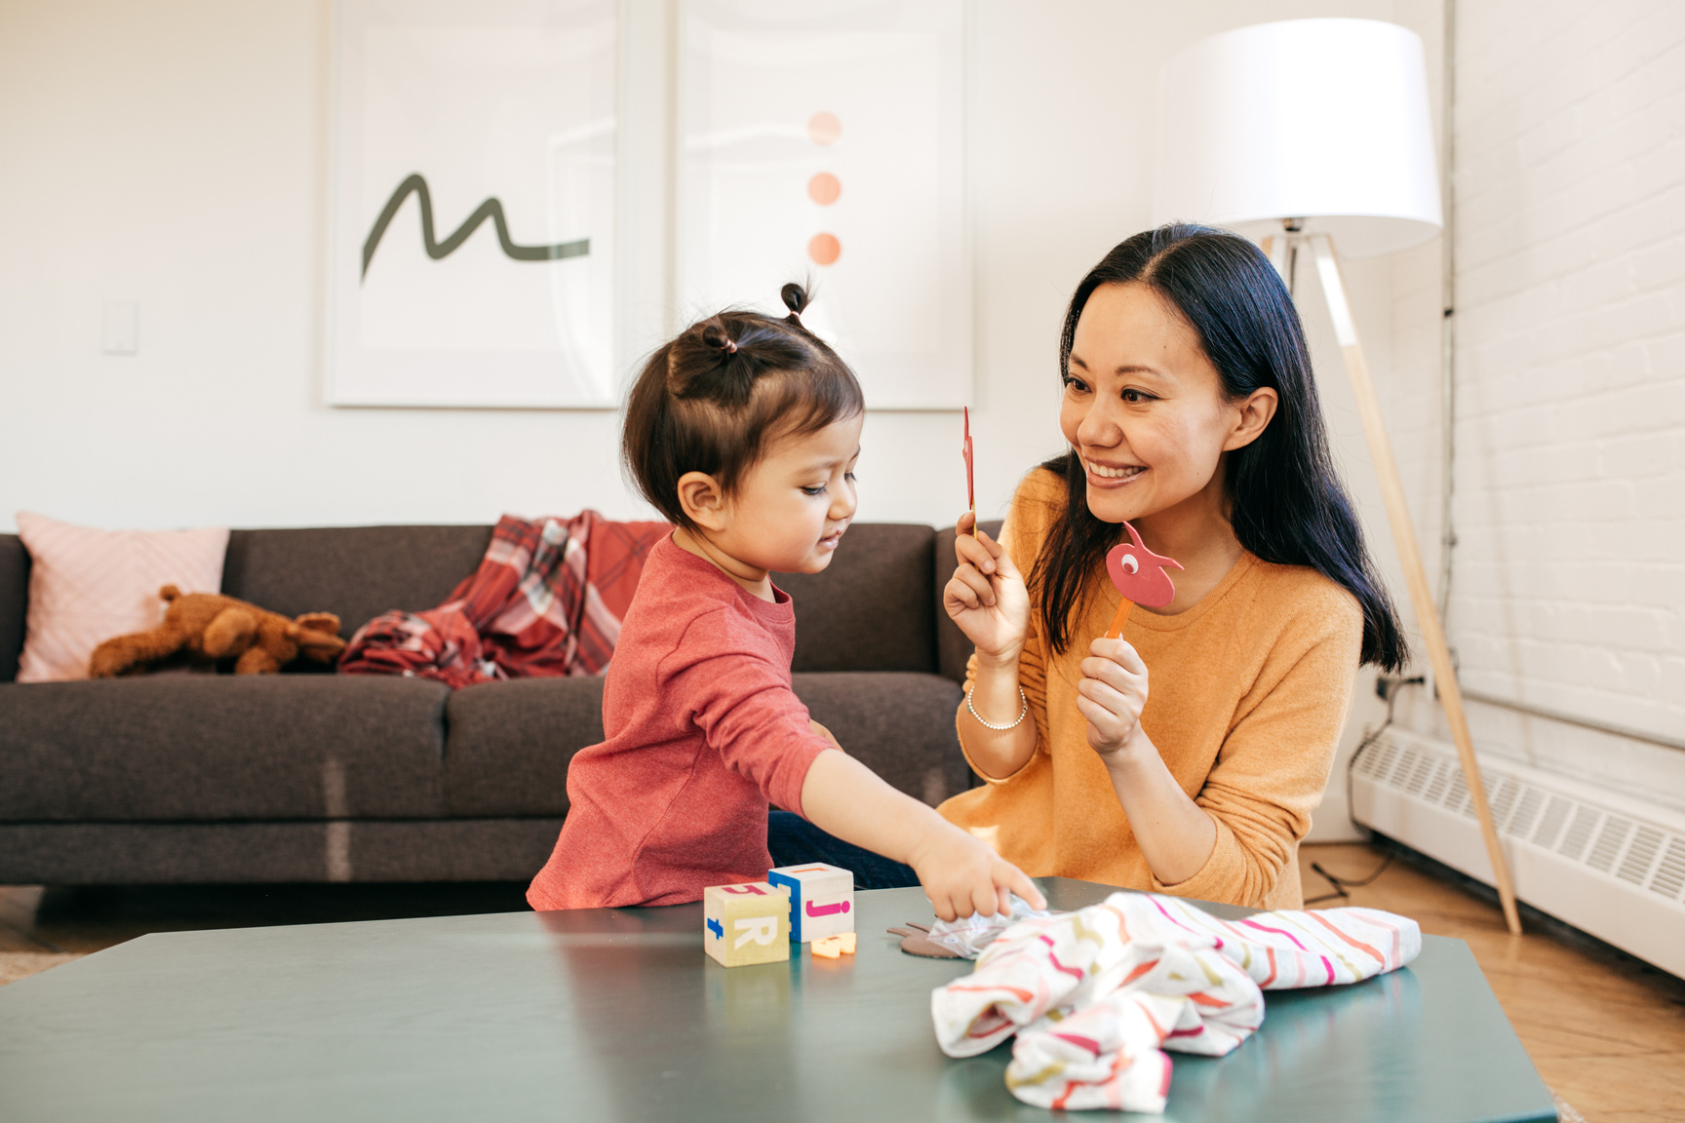



School uniform expectations
Names in uniforms.
Earrings and jewellery.
Correct P.E kit.
Trainers and shoes
Notes:
We have noticed that there have been many items of clothing that are not named. During previous meetings we have highlighted the importance of naming all of your child's clothing so that it can be returned should it get lost. Many children are also unaware of where to find their name in their clothing. Please show them where you have written their name and familiarise them with finding it.
As previously mentioned our school policy is the only jewellery permitted are small stud earrings. We have seen some children with hoop earrings and would like to ask that these are changed as soon as possible. We have also noticed some bracelets and necklaces that are not permitted for the children to wear. Please can you ensure that these are not worn in school.
Reminder of P.E kit. - no earrings on Friday.

Slide 3
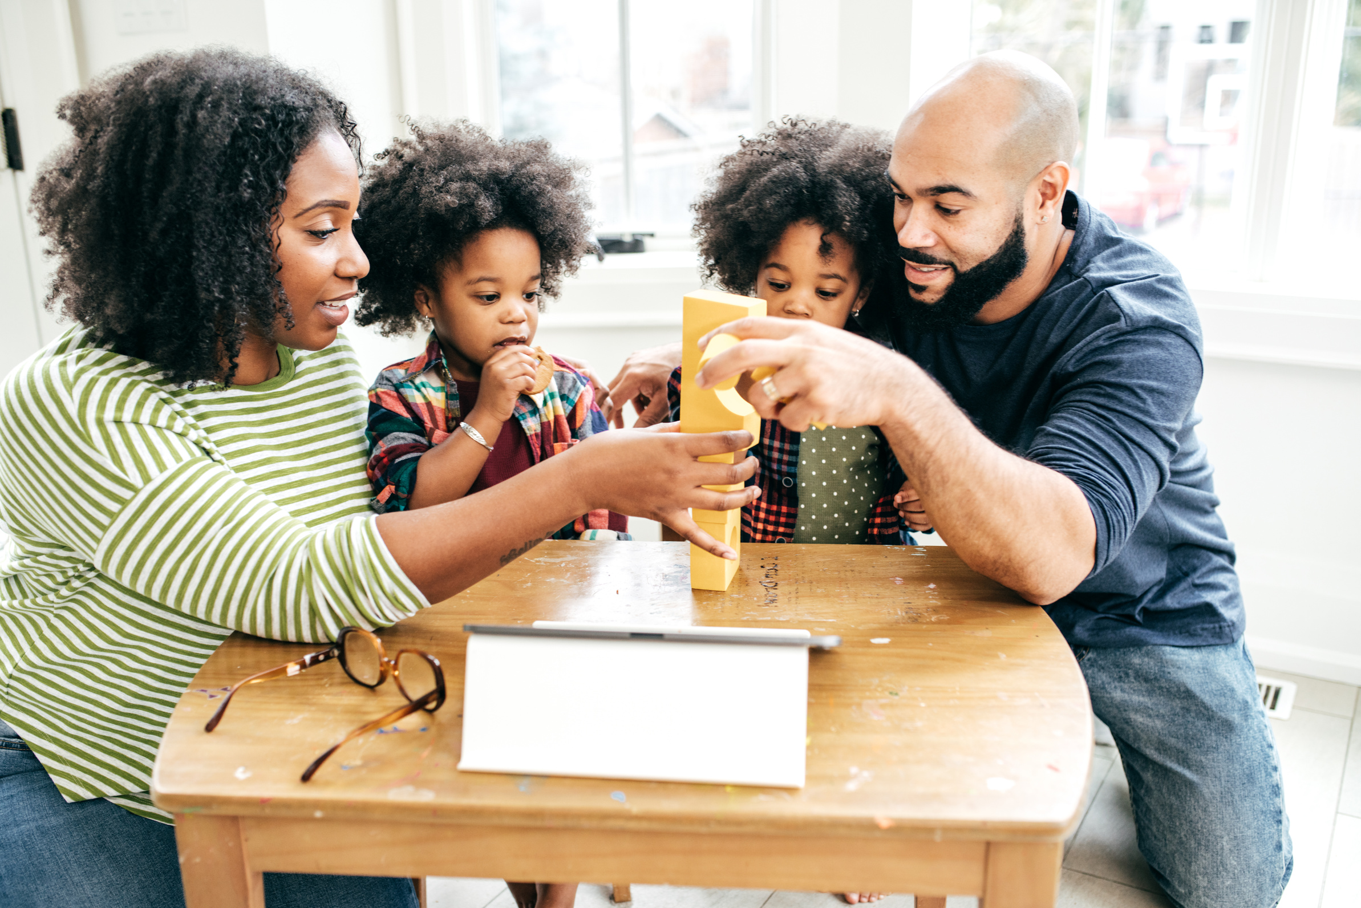


Morning routines
Waking up with plenty of
time.
Having breakfast.
Be prepared the night before.
Leave for school in time.
Notes:
Having a regular time for getting up supports children and adults to regulate their body clock and have a more restful sleep.
Breakfast is arguably the most important meal of the day. Having a health breakfast helps to wake up our bodies and minds in preparation for the day. Children who come to school having had breakfast have been proven to be more alert and ready for learning than their peers who have not.
Having all the correct equipment prepared the night before supports a smoother morning routine and promotes calmness before a busy day. Nothing worse than with 10 minutes to leave the house only having one shoe and no clean t-shirts for P.E.
We all know unexpected events can happen at anytime so planning your journey to school in advance can support your transition from home to school. Checking the weather and allowing for rain for example will allow you to leave the house with plenty of time to arrive at the school door read to enter at 8:40.

Slide 4



School timings.
8:40 - Classroom doors open.
8:55 - Registration
9:00 - Phonics
9:30 - Independent and adult led
learning
11:30 - Maths
11:50 - Lunch
1:00pm - Afternoon registration
1:10pm - Squiggle club
1:20pm - Independent and adult led
learning
2:45pm - Handwriting practice
3:15pm - Home time
Notes:
Our current timetable is as shows. This will change throughout the year to support the learning needs in the classroom.

Slide 5


Lunches
Booking of school meals must be by 12pm the day before.
Healthy lunches.
No nuts

Slide 6

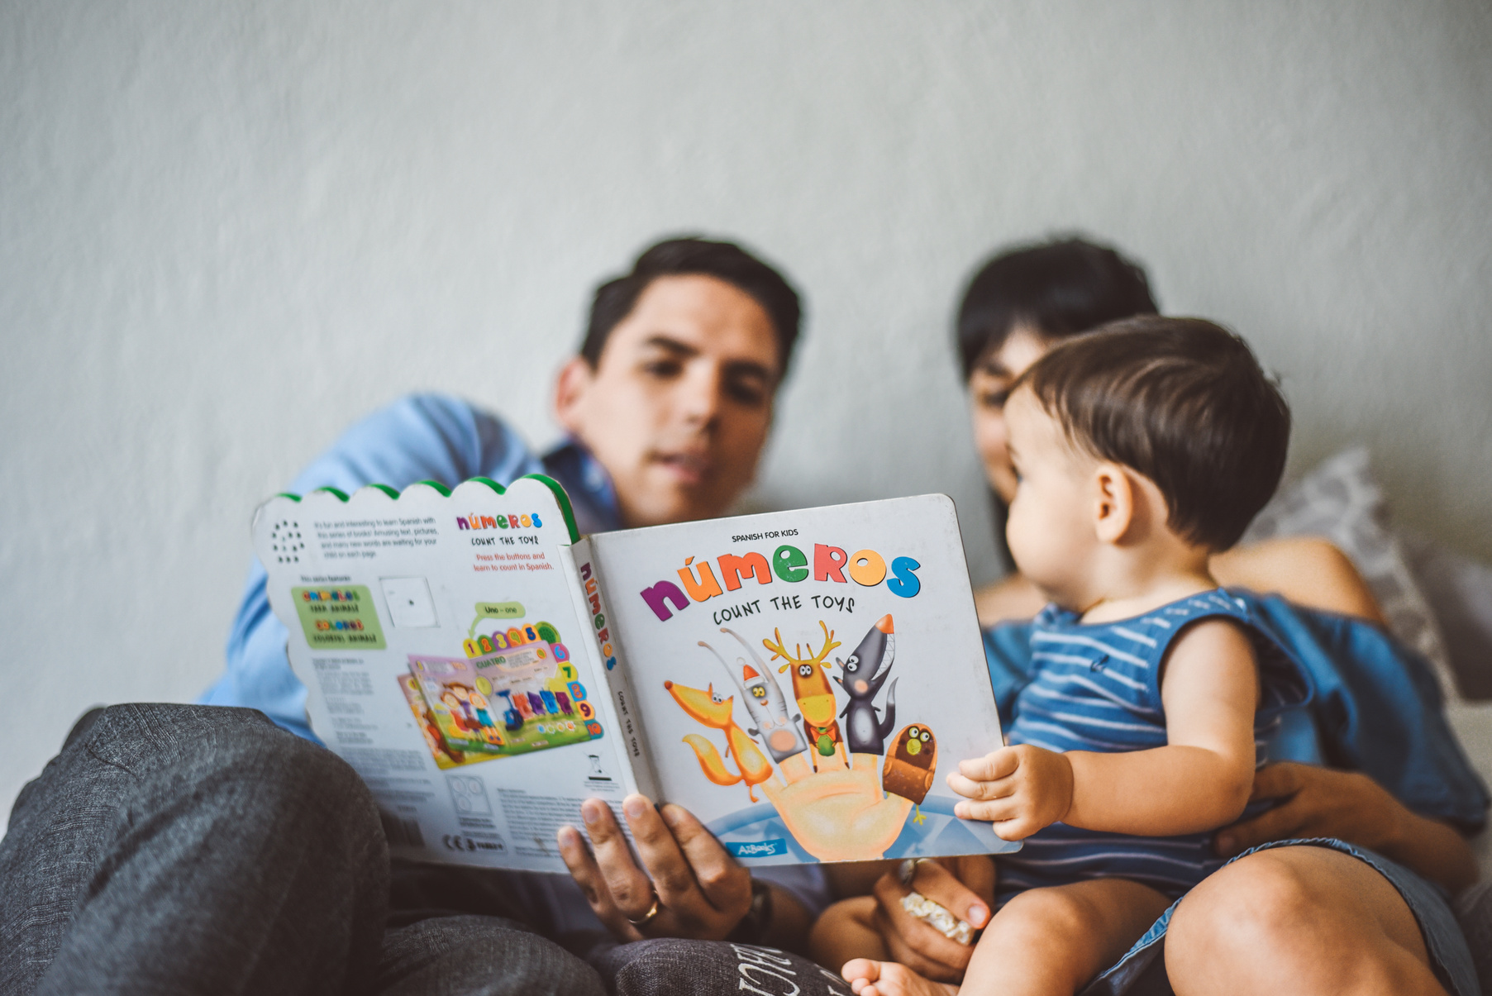


Water only School
Please provide a named water bottle.
Please only put water in your child’s bottle.

Slide 7


Homework and reading
Homework will be given on a Friday.
Homework is due back by Thursday.
Reading books are changed on a Friday.
Notes:
How can you support your child at home? Read everyday for around 5-10 minutes and log that into the reading record.
Ask you child to come and join you to complete homework tasks. Try to make this fun and inviting. If they are refusing to come then maybe try another time.

Slide 8
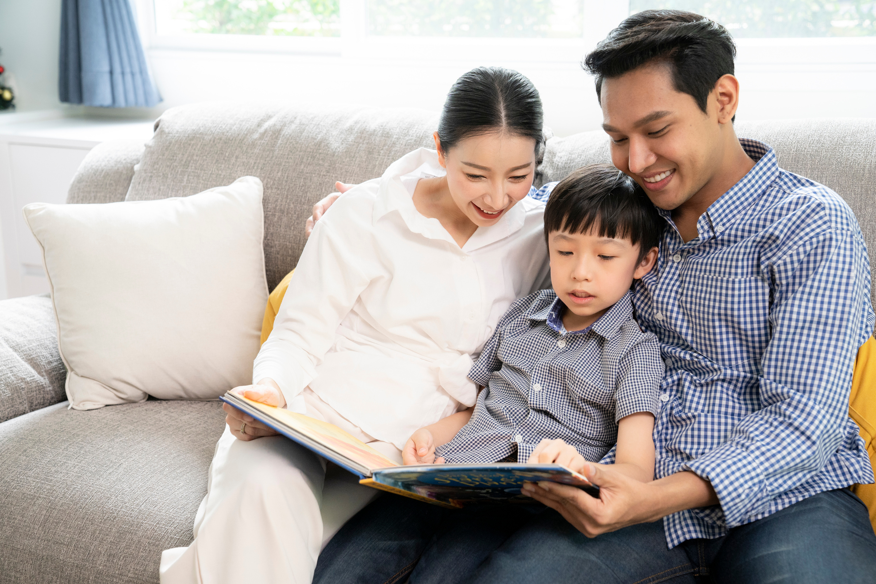
Toileting
Building independence.
Spare clothes.
Further support: ERIC website.

Slide 9
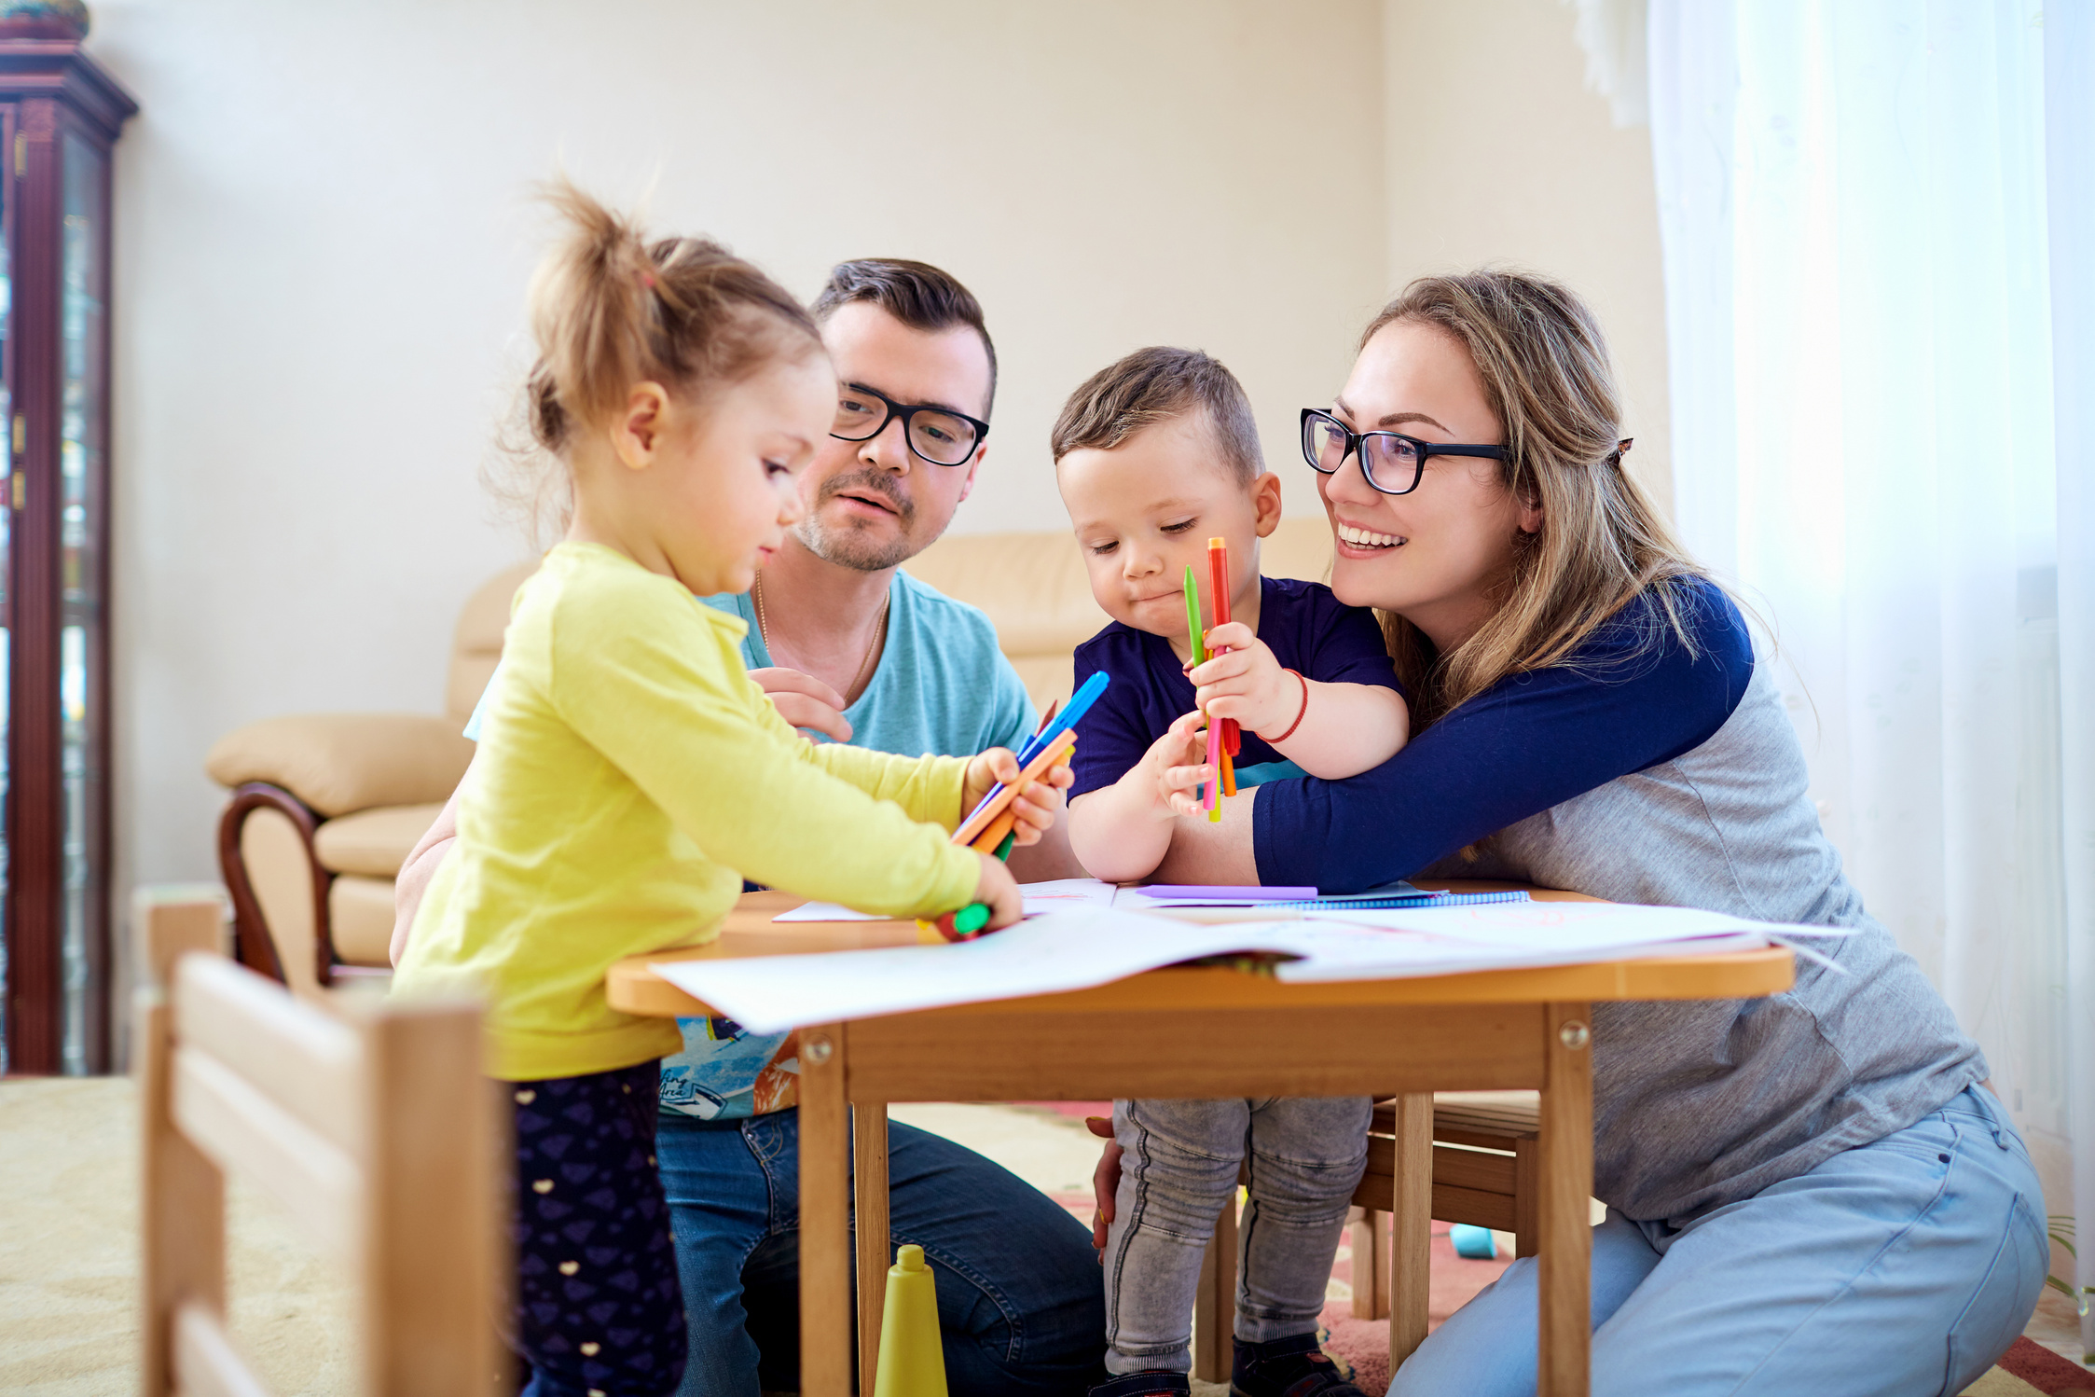

Thank You
Notes:
Our next workshop will be around bedtime routines and supporting your child to have a good nights rest.
Any questions.

